Slide 1

Airbnb Price Predictions – 03/25/21
Kapil Pundhir, Hillary Mandich, Cecilia Leung, Amaris Hassan, Caitlan Beachey

Slide 2

Airbnb Pricing Background
Notes:
This table shows you the coefficient of correlation (R2) & Mean Squared Error (MSE)
The r2 tells you how close the data fits to the regression line. MSE is the squared average difference between the actual & predicted values.
Based on the model, it tells us that the time trends have the strong impact on the price. The features have a moderate correlation to the price and the clustering have a fairly weak correlation

Slide 3
Exploratory Questions
Notes:
This table shows you the coefficient of correlation (R2) & Mean Squared Error (MSE)
The r2 tells you how close the data fits to the regression line. MSE is the squared average difference between the actual & predicted values.
Based on the model, it tells us that the time trends have the strong impact on the price. The features have a moderate correlation to the price and the clustering have a fairly weak correlation

Slide 4
Project process
Notes:
We have the following tables in our existing database. To strengthen our price model, we added 3 new tables to see how different factors like monthly, day of week & predicted prices can help hosts price their Airbnb units

Slide 5
Database Change
EXISTING
NEW
Listings Masters
Borough ID
Neighbourhood ID
Room Type ID
Yearly Rates
Monthly Rates
Day of Week Rates
Predicted Rates
Notes:
We already have information on the listings details with the yearly rates in our existing database. To understand more about rates, we added 3 new tables to see how different factors like monthly, day of week & futures prices can help hosts price their Airbnb units

Slide 6

Project Challenges
Finding the optimal data to fit in to our existing database.
Large datasets slows down the process during the data transformation process.
Limited Connections to run the free version of the PostgreSQL.
Requires many trial runs to select the right features to find the best fit for the model.
Time Consuming to run the Hyperparameter Tuning for the test results as many combinations are tested to determine the overall test score.
Notes:
→ Rest of the team to add inputs
Adding new information to our database requires extensive research to get the right dataset related

Slide 7
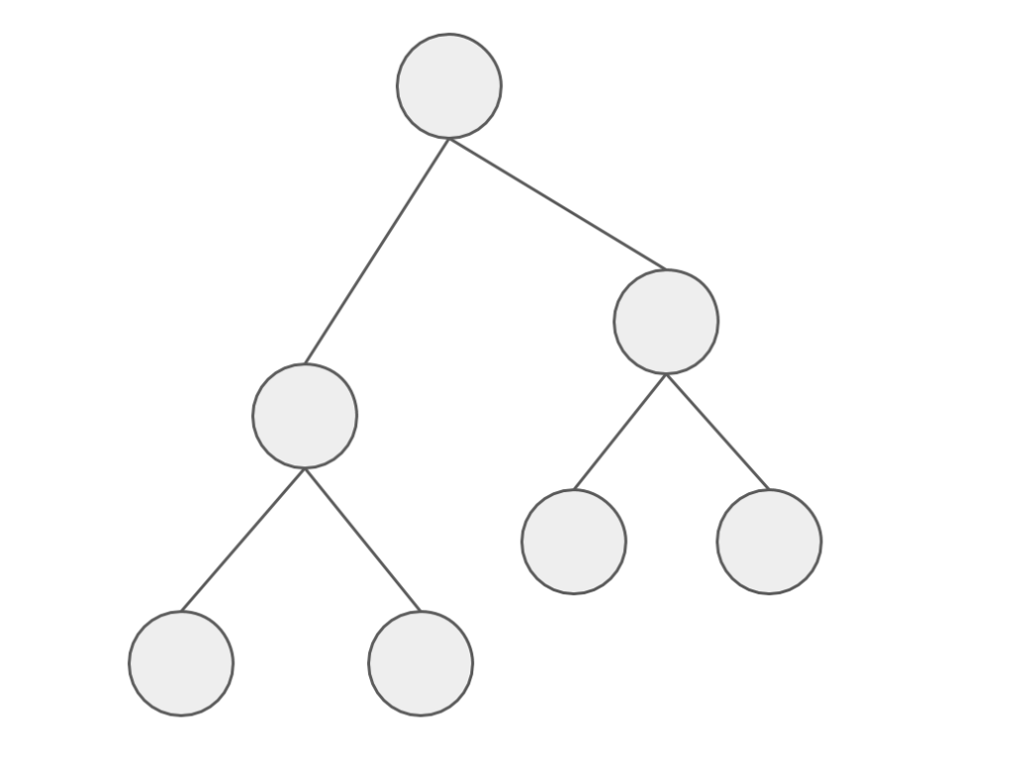
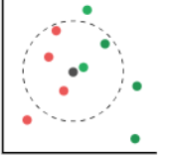
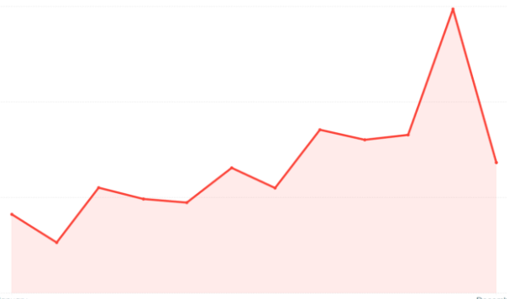
Model Analysis
Random Forest
LGBM
KNN
Facebook Prophet
Notes:
To build an Airbnb Price Predictor application, we used the Random Forest & LGBM Regressor methods to determine which feature is important when price an Airbnb unit.
Then we use the KNN Regressor to see how the price is affected with having listings close to your area.
Finally, we used the Facebook Prophet to how prices are affected by time & seasonality to predict Airbnb future prices.

Slide 8

Model Findings
Slight upward trend in the future.
Location is a key factor that segregates the rates from one area to another.
Low-Moderate clustering impact in predicting prices based on local average of a specific area.
Room Type and Accommodation Features are major factors that determine the price.
Seasonality and Trends have a big impact on how to price your listings.
Amenities are only nice-to-have features that have a slight impact in your Airbnb listings.
Notes:
Here are some of the key findings after running all the models.
The predictor model shows there will be a slight increase in prices for 2022 to 2023.
Centrally located listings and reputable neighbourhoods usually sets the tone of your listings.
However, the host shouldn’t just look at the location and set the average price for the specific area. There are other important factors that the host should look at.
4) This includes the size of the unit where the bigger the unit and more accommodation features like bedrooms and bathrooms can increase the rates
Timing is important as the rates can fluctuate at different times of the year. Different seasons, holidays, long weekends and regular weekends can help the hosts maximize profits.
6) Having more amenities in your units may add a bit value in your unit. But it is not the first thing customers look into when booking an Airbnb

Slide 9
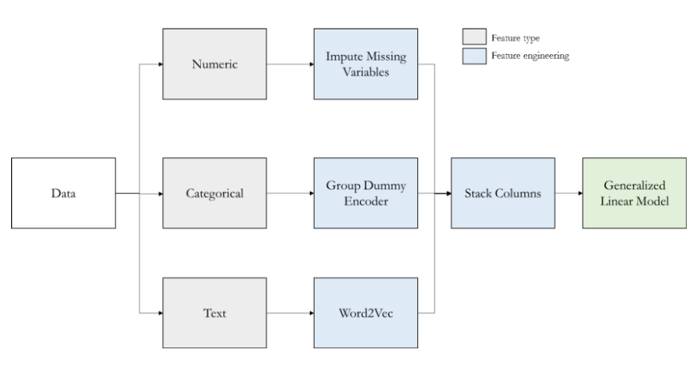
Model Data Transformation – Regressors
Note: Used for Random Forest, LGBM and KNN Regressor Models only
Notes:
This table provides an overview of what we need to do to try to find the best fit for the model. As you can see on the grey boxes, we need to work with different types of data and find ways to engineer the data to run the models. The next few slides will provide a breakdown how we get to the final data to run the model.

Slide 10
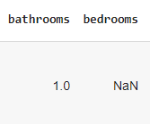


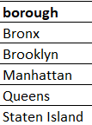
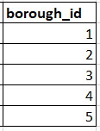

Model Data Transformation - Regressor
1. Imputing Missing Numerical Data
2. Encoding Categorical Data
3. Vectorizing Text Data
Notes:
For the RF, LGBM, and KNN we first, replaced the blank fields with the averages for that specific column
In the next step, we need to put the data and categorize them in numerical values and majority of this was done from our last project.
Finally, for the amenities column, we made a vector array counting the amenities features for each listing.

Slide 11
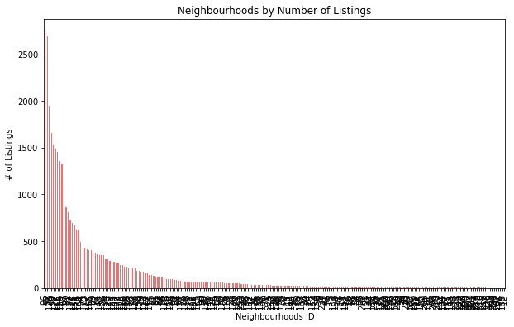
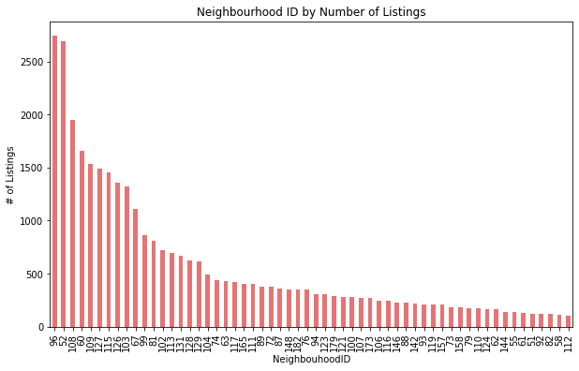
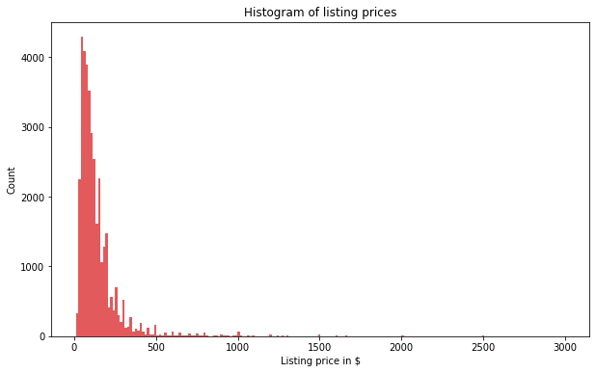
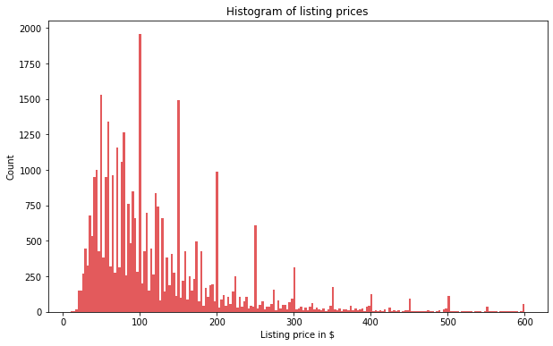
Model Data Transformation - RF, LGBM, KNN
4. Removing Outliers
Filter for:
1. ≥100 Listings
2. ≤ $600/night
Notes:
To get the best selection of listings that best represents NYC’s Airbnb market, outliers are filtered out by only keeping the neighbourhoods with over 100 listings & the listing prices that are under $600.
From the right side of the slide, you can tell the data is less skewed.

Slide 12
Model Data Transformation – FB Prophet
Borough
Room Type
Historical Rates
Holiday Dates
Existing
New
Prophet Model Datasets
Notes:
For the facebook prophet model, another dataset needs to be created because the model has a different methodology than the previous models/
We used our existing data to find the listings masters data to get the borough and room type.
Then we need to created new datasets to find all the historial rates & holiday dates from 2017-2021. All this information is found on the inside Airbnb & us holiday calendar website.
Various methods like concatenation, filtering, merging, renaming columns and calculating the mean prices were used in Pandas to get our Final output
We believe that putting all f this together can help us accurately predict prices based on location, size, accommodation features, trends and seasonality.

Slide 13

Preprocessing Model Data
RF, LGBM, KNN Regressors
Define features (X-value) that have the most impact on the price (y-value)
Change test data size from 25% to 35% to provide more data to increase accuracy of the models.
Scale the X-values for normalizations to ensure all features are the same unit.
FB Prophet
Group the prices based on borough and room type for the predict future prices.
Notes:
The next step is that we need to select the features that are related to price. We collectively agreed that features like location, the room type, # of bedrooms/bathrooms, amenities count review scores, # of reviews are some of the major driving force that impacts what the hosts charge for their Airbnb. Columns like Airbnb listings id are taken out because they do not have any correlation to the price.
Then we increased the dataset size by 10% so that more listing simples can be tested to increase the accuracy of the test scores.
We must ensure that all x-values are scaled to the same unit so that the model won’t produce the wrong scores.
As for the prophet model, we added the holiday feature, borough and room type info form the original code so that the model can predict the prices based on these criteria.

Slide 14

Running the Model
Fit X and y data in the model.
Determine Coefficient correlation (r^2)
Determine Mean Squared Error (MSE)
Hyperparameter Tune the Model
Notes:
The we fit the X & y data to run the model. Then we found the coefficient correlation score to see how the data fits in the best fit line.
Also we calculated the mean squared error, this is just the squared difference of the actual and predicted prices. If these values did not produce the correct score, we did some hyperparmeter tuning to improve the scores of the model.

Slide 15
Model Results
 | Random Forest (Features) | LGBM (Features) | KNN (Clustering) | FB Prophet (Time)
R² | 53% | 56% | 41% | 84%
MSE | 62.1 | 60.3 | 69.9 | 31.8
R2 = Coefficient of Correlation
MSE = Mean Squared Error
Notes:
After we ran the model, it displays the following results.
The table shows the r2 & mse scores for all models. I have put down which factors the different models look at in brackets.
Looking at the results, KNN has the lowest scores in both the correlation and mean squared error. Probably the model only looks at what the closest neighbour has without looking too much into the different features.
So the hosts will need to look at the room type, amenities, and accommodation features to scale their rates accordingly.
Finally, the hosts can maximize their revenue by looking at the traveling demands during different times of the year. For example, rates can be priced higher during the weekends, summer months, and on major holidays like Christmas.
The next slide will show the result breakdown of the Airbnb pricing model.

Slide 16
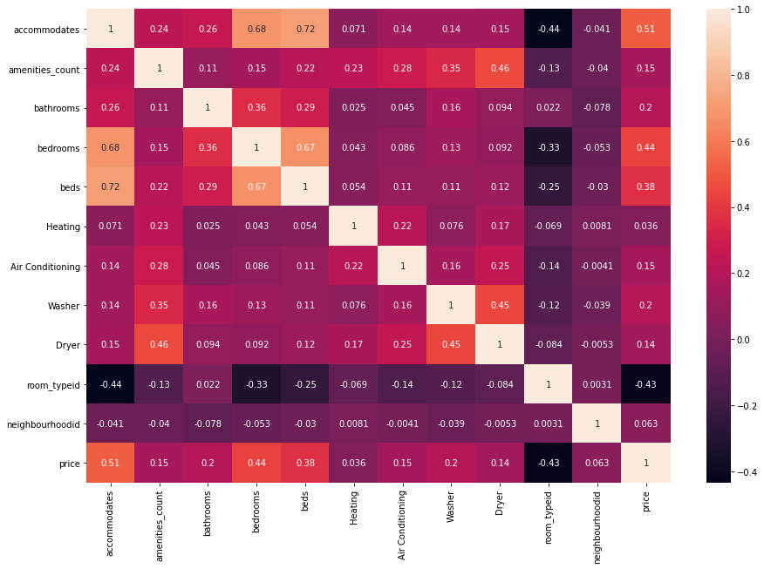
Model Results - Price Correlation
Top 5 Features
Accommodates
Bedrooms
Beds
Bathrooms
Washer
Notes:
In this slide we look at the price correlation versus the accommodations and amenities. the yellow box here shows the price correlation to the accommodations and amenities.
On the right side of the slide, we listed the top 5 features that have the most impact on the price.
Just by looking figures, the heatmap implies that size and basic accommodations have a moderate impact on the prices. Having more amenities like washer and air conditioning are nice to have features that can help increase the rates.

Slide 17
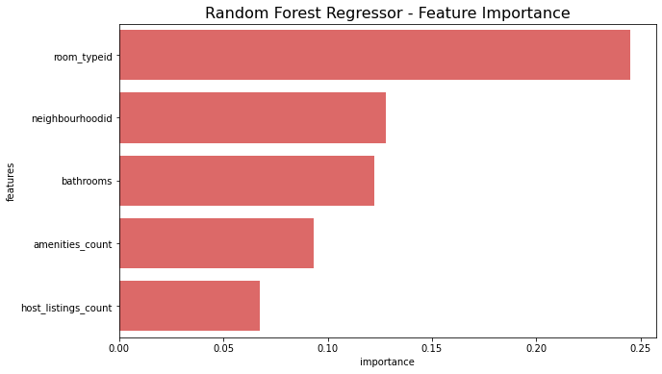
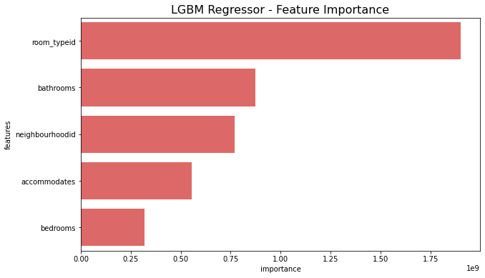
Model Results – Features Importance
Room Types, location and accommodations are some of the most important features.
Notes:
After running the random forest and LGBM Regressor models, we got the 5 most important features.
Both models show that the most important features areroom type, the neighbourhood and the # of bathrooms the unit has.
Once again, size & accommodation requirements are the major forces of determining the prices. Another implication from this model tells us that where the listing is located is also very important

Slide 18
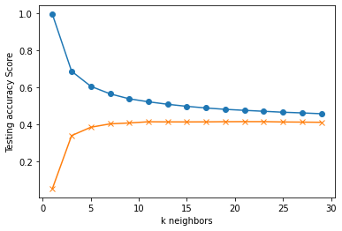
Model Results – Nearest Neighbours
Notes:
Since location is one of the stronger components based on the RF & LGBM model, we wanted to use the KNN model to determine how effective it is with averaging the price of your model to your nearest neighbour.
As you can see in this graph, the model score is quite low. This may potentially be since NYC is a large city that offers various units in different room types in just one neighbourhood. As you know the price range is quite large between an entire home vs a shared room. So when the host price their units, they can’t just factor in their location, they need to look also into the accommodation and the size of their units.

Slide 19
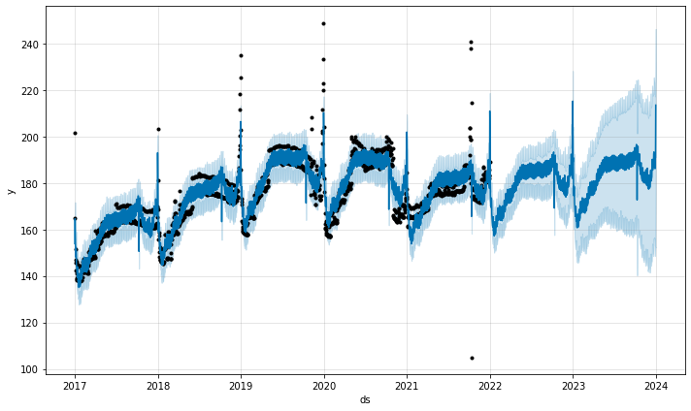
Model Results – Trends
Downward Trend
Upward Trend
Slight Increase
Notes:
Graph shows the overall actual trends & predictions. The black dots are the actual average daily prices from our datasets. The dark blue lines are the predicted prices, and the light blue area are the upper & lower limits of the predicted prices.
As you go further in the future, the limits increase as there are more uncertainty factors.
Overall trends of this graphs shows that
Prices has been increasing from 2017 up to the first part of 2020.
Downward trend after the second part of 2020 due to Covid-19.
2021 rates is at the lowest as the economy is greatly impacted by the pandemic.
For 2022-23, it shows a slight increase in the prices based on past trends and incorporate the sudden decrease form Covid-19.

Slide 20
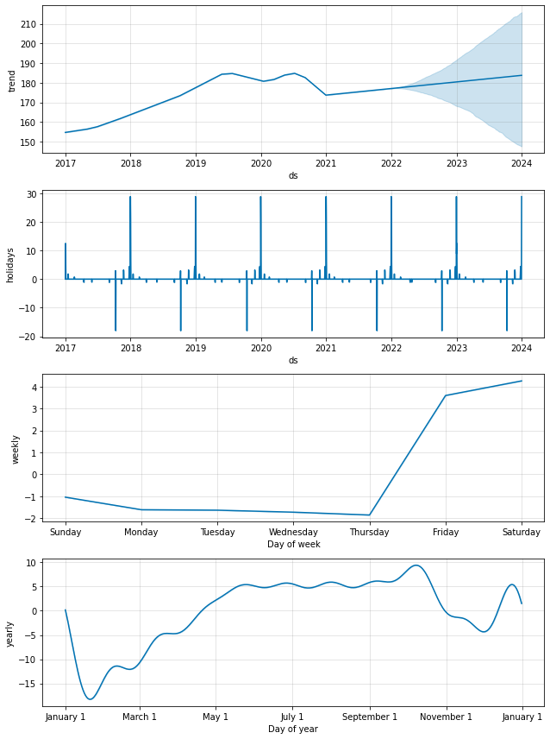
Model Results – Trends & Seasonality
Peak holiday seasons are Christmas, New Years and Long Weekends.
High Demands for Airbnb Rentals on the Weekends.
Summer months tend to have higher rates than winter months.
Notes:
The prophet model here breaks down the rates in different time components by holidays, months and day of week.
On the first chart, it shows that the Christmas breaks and long weekends have the highest impact on rates as people likely take vacations during longer breaks from work and school.
With that being said, the weekly chart indicates the highest rates are on Friday & Saturday which falls into the weekend.
Finally, it shows that the different months of the year have a big impact on the rates. The summer months are predominantly higher likely because the weather is nicer and most families travel when their kids do not have schools for the summer.

Slide 21
Final Price Predictor Model
Modified Facebook Prophet Model that predict prices :
From 2017 - 2023
By Boroughs
By Room Type
Show Dashboard Image
Notes:
This table shows you the coefficient of correlation (R2) & Mean Squared Error (MSE)
The r2 tells you how close the data fits to the regression line. MSE is the squared average difference between the actual & predicted values.
Based on the model, it tells us that the time trends have the strong impact on the price. The features have a moderate correlation to the price and the clustering have a fairly weak correlation

Slide 22

Pricing Considerations for NYC Airbnb Hosts
Maximize revenue by increasing rates during normal and long weekends, summer months, and holidays like Christmas.
Rates in boroughs like Manhattan and Brooklyn have the higher rates as it is the central part of New York City.
Do extensive research on how neighbours price their units based on the size of the unit.
Prices increase by providing more accommodation features like bedrooms & bathrooms.
Prices do have a slight increase by providing more amenities.
Beware of major news events or pandemic crisis that may decrease occupancy rates dramatically.
Notes:
This table shows you the coefficient of correlation (R2) & Mean Squared Error (MSE)
The r2 tells you how close the data fits to the regression line. MSE is the squared average difference between the actual & predicted values.
Based on the model, it tells us that the time trends have the strong impact on the price. The features have a moderate correlation to the price and the clustering have a fairly weak correlation

Slide 23

Looking into the Future
Use AWS for the ETL to increase processing time and memory space
Add Neighbourhood Feature in the Prophet Model
Explore other Regressor Models
Webscrape New York City news info and include in Dashboard
Look into customer demographics to see types of units they book.
[Gentrification] → Amaris to provide input
Notes:
This table shows you the coefficient of correlation (R2) & Mean Squared Error (MSE)
The r2 tells you how close the data fits to the regression line. MSE is the squared average difference between the actual & predicted values.
Based on the model, it tells us that the time trends have the strong impact on the price. The features have a moderate correlation to the price and the clustering have a fairly weak correlation

Slide 24
Dashboard Demo
Notes:
So & so we demo the dashboard

